Slide 1
Updates to the Air Cadet Badge System

Slide 2
Badge Changes
Level proficiency badges have been reduced in size. Completed training is now represented by a roman numeral.
Due to the reduced size of the proficiency level badge, there is no requirement for a WO2 / WO1 to remove this badge upon promotion.
A number of music qualification badges have been altered or eliminated. Music proficiency levels are now represented by a music note containing a roman numeral which is worn as one of the group of qualification badges.
No other badges are worn in coordination with this badge with the exception of Drum / Pipe Major Badges which have been reduced in size (music levels are no longer worn underneath these badges).
The St. John’s Ambulance First Aid badge has been replaced by a common first aid badge (a Greek cross containing a roman numeral) which is worn as one of the group of qualification badges.
Cadets holding a certification in standard or emergency first aid from any authorized Canadian provider (St. John’s Ambulance, the Royal Lifesaving Society, or the Red Cross) may be issued these badges.

Slide 3
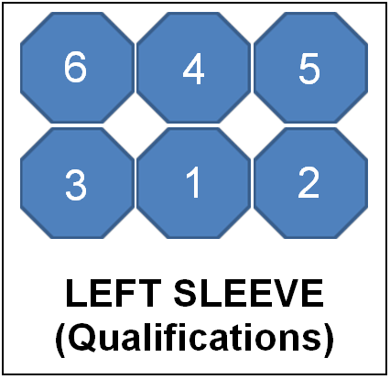
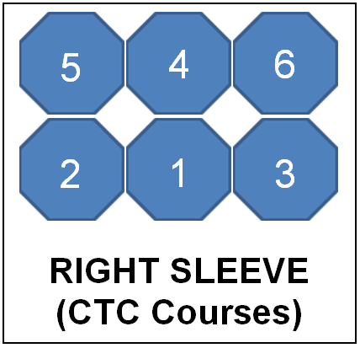
Badge Placement
Qualification badges will be worn as above the right cuff.
CTC course badges will be worn above the left cuff.
Badges are sewn to the tunic in the following order (looking at the cadet from the front): centre (1), front(2), rear(3), centre(4), front(5), rear(6)

Slide 4
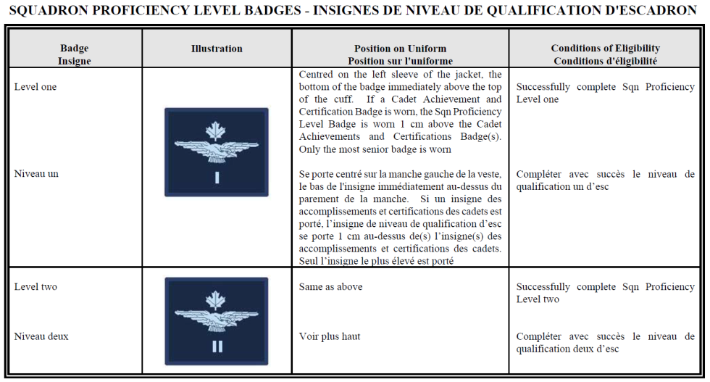

Slide 5
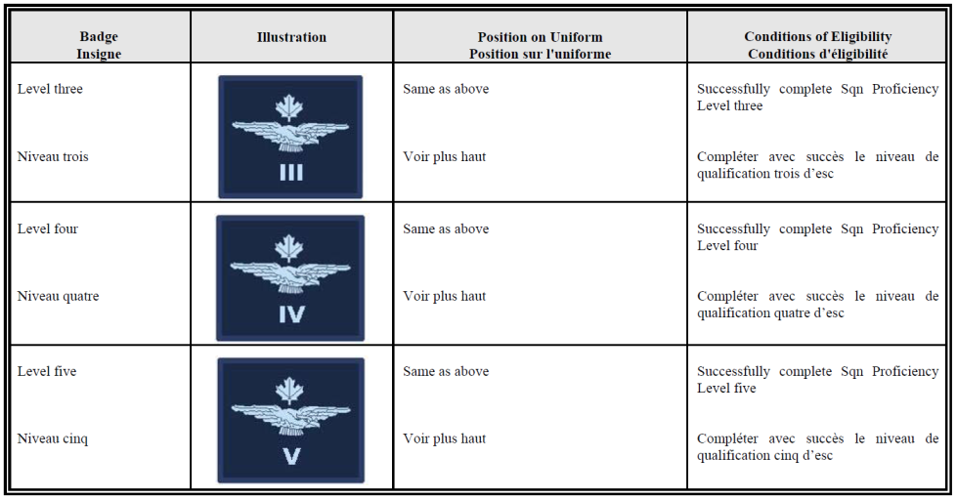

Slide 6
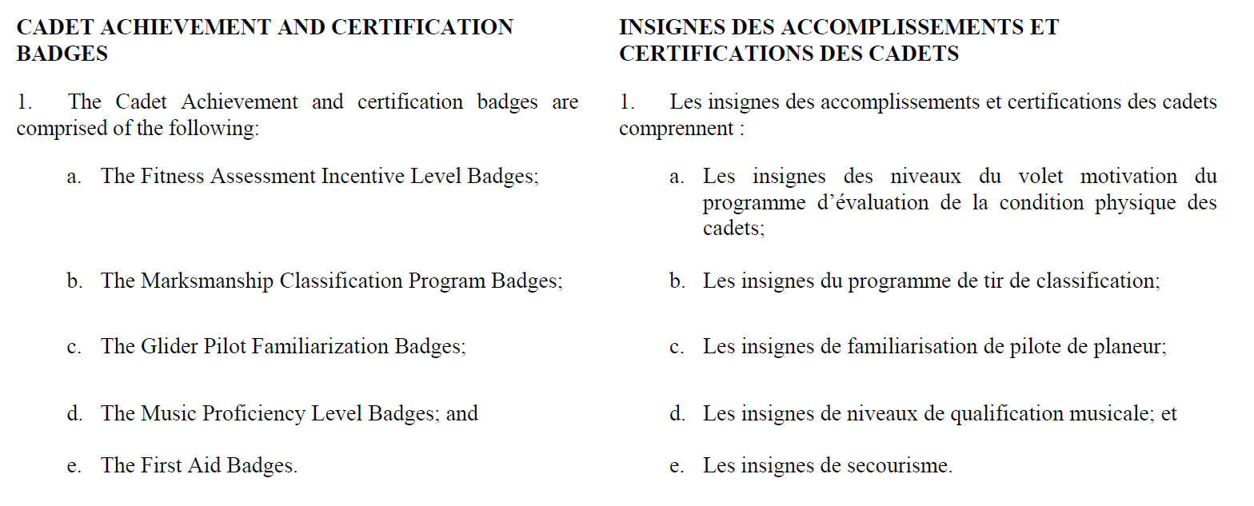

Slide 7
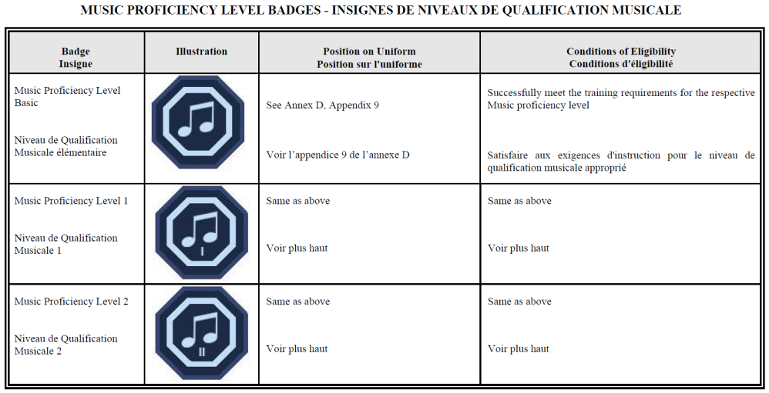

Slide 8
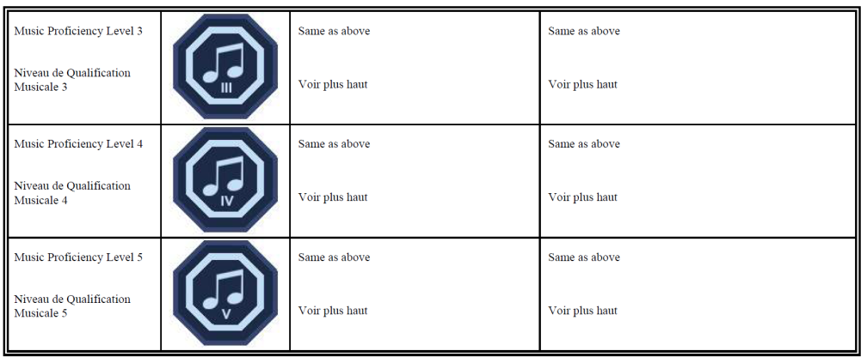

Slide 9
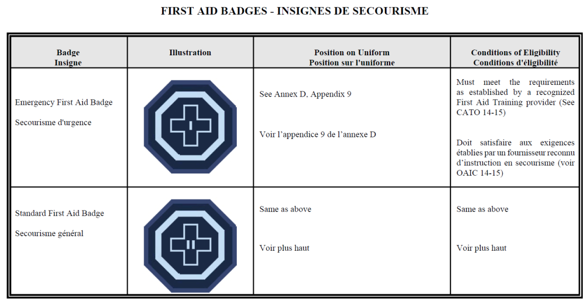

Slide 10
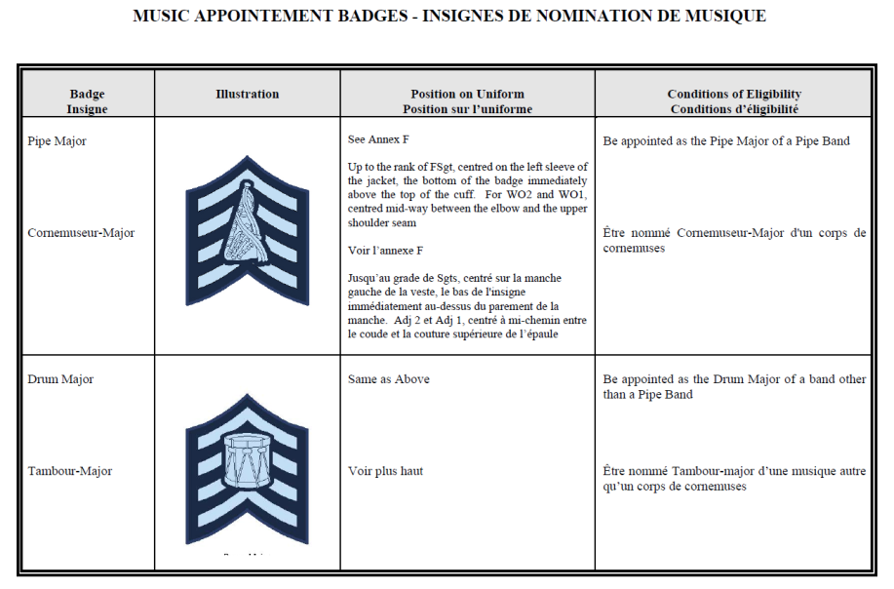

Slide 11
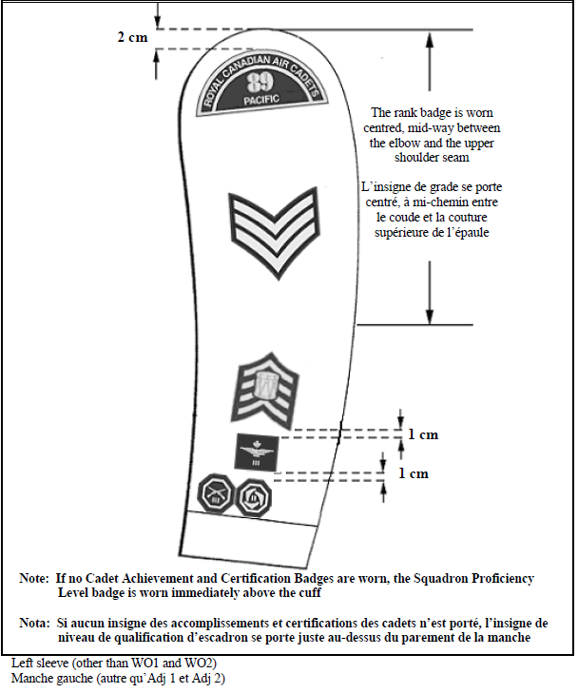

Slide 12
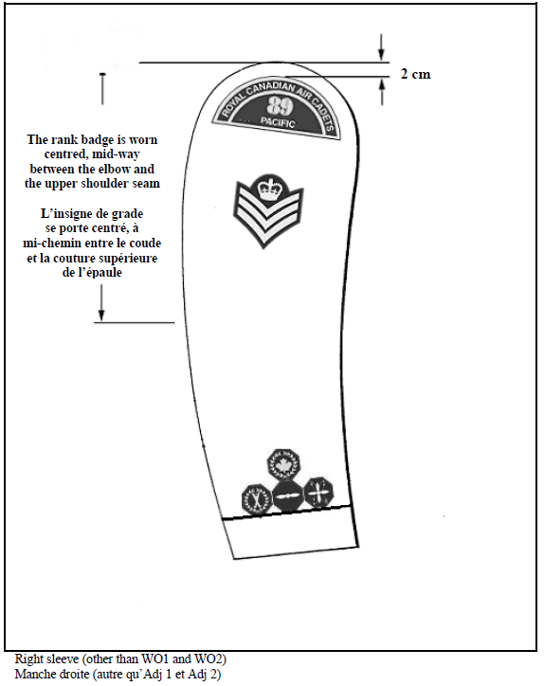

Slide 13
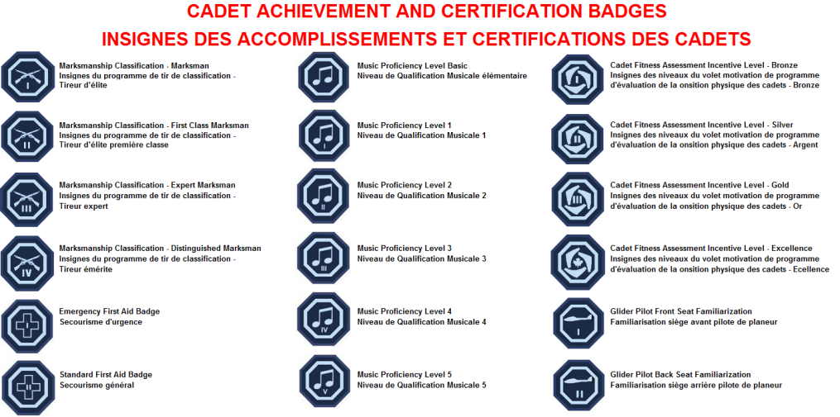
Qualification badges are available for through Squadron Logistic Unicorp accounts.
Summer Training Course badges are available from the CTC or RCSU

Slide 14
